Slide 1
The Mechanism of Speech and Organs of Speech
Presentation By-
Anshu SIngh

Slide 2
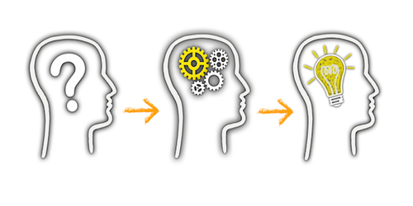
Introduction
The production of Speech is a complicated process.
First of all a concept is formulated in a linguistic form in the speaker’s brain and then a message is transmitted to the organs of speech by nervous system.
When the organs of speech move to produce the speech sounds, they cause “disturbance in the air in the form of varying air pressure and these sound waves strike listener’s ear”.
The listener’s ears receive these waves which are conveyed to his brain by the nervous system.
It is the brain , the message is decoded or interpreted. Hence , it becomes essential that the speaker as well as the listener should share a common linguistic code.

Slide 3
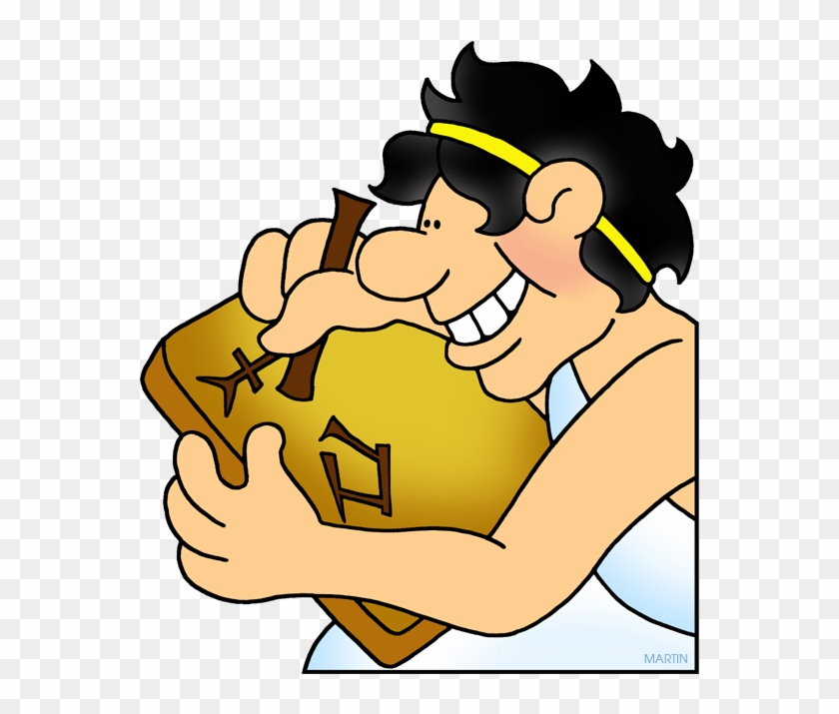
Code and Content of Communication Skill
Code : “ A group of symbols that can be structured in a way that is meaningful to another person.”
OR
Code is a system of Rules to convert information into another form or presentation.”
In a way all languages are codes.

Slide 4

Code and Content of Communication Skill
Content : “Text matter of a document or publication in any form.”
OR
Content is what is inside or included in something.
Example: Words inside a book

Slide 5
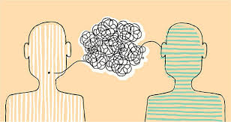
Stimulus and Response in Communication
Any Message or Information that evokes a response is Stimulus.
Response is defined as a rection to stimulus.
Communication is a two way process hence stimulus(message) caused by the sender leads to a response (reaction after receiving the message) by the receiver.

Slide 6
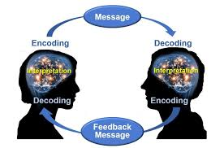
Encoding and Decoding In Communication
The sender Encodes his message i..e he translates in the form of symbols.
The listener or the receiver decodes the encoded message i..e he interprets the encoded message.

Slide 7
Pronunciation in Communication
Pronunciation refers to the way a word is spoken.
It affects the way we communicate
Right pronunciation helps in communicating more effectively while improper pronunciation leads to misunderstanding and ineffective pronunciation.

Slide 8
Etiquette in Communication
Communication etiquette in the workplace is an important skill to master.
Peter Murphy has mentioned ten secrets of social etiquette in conversation
Don’t hijack the conversation.
Give people time to speak.
Invite others in conversation
Also Ask question
Give people a chance to answer to answer and make sure you listen.

Slide 9
Etiquette in Communication
Respect others opinion
Don’t rain on someone’s parade.
Don’t be know it all
Don’t make dis agreement Personal
Difficult conversations were never meant to beeasy

Slide 10

The Organs of Speech
The respiratory system, consisting of the lungs, the muscles of the chest, and the wind-pipe (trachea)
The phonatory system, formed by the larynx
The articulatory system, consisting of the nose, the mouth (including the tongue, the teeth, the roof of the mouth, and the lips)

Slide 11
Organs of Speech
Respiratory System
Phonatory System
Articulatory System
Lungs
Muscles of the chest
Trachea
Pharynx
Lips
Teeth
Roof of the mouth
Tongue
Larynx
Vocal cords
Teeth ridge
Hard palate
Soft palate
Uvula
Tip
Blade
Front
Back
Rims

Slide 12
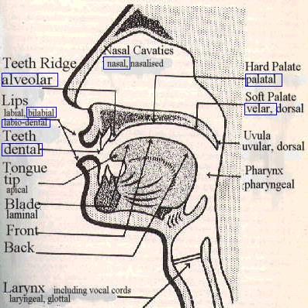
The Organs of Speech

Slide 13
The larynx
The air from the lungs comes through the wind pipe or trachea, at the top of which is the larynx.
In the larynx are two vocal cords, which are like a pair of lips placed horizontally from front to back.
They are joined in the front, but can be separated at the back, and the opening between them is called the glottis.

Slide 14
The roof of the mouth
The roof of the mouth can be subdivided into four parts:
the teeth-ridge or the alveolar ridge, i.e., the hard convex surface just behind the upper front teeth
the hard palate, i.e., the hard concave surface behind the teeth-ridge
the soft palate, i.e., the soft portion behind the hard palate
the uvula, i.e., a small fleshy structure at the end of the soft palate

Slide 15
Consonants and Vowels: Two broad categories of sounds
The description of a consonant includes the following description:
the nature of the air-stream mechanism
pulmonic / glottalic / velar , egressive / ineggressive
the state of the glottis
voiced / voiceless/ whispered
The position of the velum or the soft palate
The articulators involved (i.e, the place of articulation)
The nature of stricture involved (i.e., the manner of articulation)

Slide 16
The Air-Stream Mechanism
Three types of air-stream mechanism:
pulmonic
in which the lungs and the respiratory muscles set the air-stream in motion
glottalic
in which the larynx, with the glottis firmly closed, is moved up or down to initiate the air-stream
Velaric
in which the back of the tongue in firm contact with the soft palate is pushed forward or pulled back to initiate the air-stream

Slide 17
The Air-Stream Mechanism
These air-streams can be:
Egressive, i.e., the air is pushed out
e.g., Sounds of English and Hindi are produced with egressive pulmonic air-stream.
Inegresive, i.e., the air is pulled in
e.g., Sindhi has some sounds produced with an inegressive glottalic air-stream.

Slide 18
The State of the Glottis
When we breath in and out, the glottis is open. That is, the vocal cords are drawn wide apart producing voiceless sounds.
If the vocal cords are held loosely together, the pressure of the air coming from the lungs makes them vibrate; that is, they open and close regularly many times a second. Sounds produced in this way are called voiced sounds.

Slide 19
State of the soft palate
Raised
Lowered
Nasal passage blocked
Nasal passage open
Oral sounds produced
Oral passage blocked
Oral passage open
Nasal sounds produced
Nasalized sounds produced

Slide 20
The Articulators
The organs of speech above the glottis are the articulators involved in the production of consonants:
Active articulator
the lower lip and the tongue
Passive articulator
the upper lip, the upper teeth, the roof of the mouth and the back wall of the throat (or Pharynx).
In the production of a consonant, the active articulator is moved towards the passive articulator.

Slide 21
The Nature of Stricture Involved-I
that is, the different ways in which the passage of air is restricted in the production of consonants
Complete closure
The active and the passive articulators making a firm contact with each other, thus preventing the passage of air between them. E.g., /p/, /b/
Complete oral closure
The active and passive articulators make a firm contact with each other, thus preventing the passage of air between them, but the soft palate is lowered, thereby allowing the air to escape through the nose. E.g., /m/, /n/

Slide 22
The Nature of Stricture Involved-II
Intermittent closure
The air passes between the active and passive articulators intermittently. It involves the vibration of the active articulator against the passive. [Scottish r]
Flap
For some consonants the active articulator strikes against the passive articulator once only. /r/ in very
Close approximation
The two articulators are brought very close to each other so that the space between them is very narrow. E.g., /f/, /v/, etc.

Slide 23
The Nature of Stricture Involved-III
Partial closure
There may be a contact of the articulators in the centre of the vocal tract but the air may pass through the sides. e.g., /l/
Open approximation
The two articulators are brought close to each other but the space between them is wide enough for the air to escape without friction. E.g., all vowels and the English /j/ and /w/ as in yes, west.

Slide 24
The Place of Articulation - I
The place of articulation simply means the active and passive articulators involved in the production of a particular consonant.
A few are:
Bilabial : The two lips are the articulators. E.g., /p/, /b/, /m/
Labio-dental: The lower lip is the active articulator and the upper teeth are the passive articulators. E.g., /f/, /v/
Dental: the tip of the tongue is the active articulator and the upper front teeth are the passive articulators.

Slide 25
The Place of Articulation - II
Alveolar: The tip or blade of the tongue is the active articulator and the teeth-ridge is the passive articulator.
Post-alveolar: The tip of the tongue is the active articulator and the back of the teeth-ridge is the passive articulator.
Retroflex: the tip of the tongue is the active articulator, and it is curled back. The back of the teeth-ridge or the hard palate is the passive articulator.

Slide 26
The Place of Articulation - III
Palato-alveolar: The tip, blade, and front of the tongue are the active articulators and the teeth-ridge and hard palate are the passive articulators.
Palatal: The front of the tongue is the active articulator and the hard palate is the passive articulator.
Velar. The back of the tongue is the active articulator and the soft palate is the passive articulator. E.g. /k/, /g/

Slide 27
The Place of Articulation - IV
Uvular: The rear part of the back of the tongue is the active articulator and the uvula is the passive articulator. There are no uvular sounds in English.
Glottal: Produced at the glottis. E.g., [h]

Slide 28
The Manner of Articulation - I
According to the manner of articulation consonants are usually classified as follows:
Plosive: In the production of a plosive, there is a simultaneous oral and nasal closure. The air behind the oral closure is compressed and when the active articulator is removed suddenly from contact with the passive one, the air escapes with an explosion.
Nasal: A nasal is produced by a stricture of complete oral closure, but in this case there is no closure of nasal passage. The soft palate is lowered and the air passes through the nose.

Slide 29
The Manner of Articulation - II
Trill (rolled consonant) The active articulator taps several times against the passive articulator (i.e., stricture of intermittent closure). E.g., [r] in horse.
Flap: For a flap the active articulator strikes against the passive articulator once only. E.g., [r] in very.
Lateral : A lateral consonant is produced by a stricture of closure in the centre of the vocal tract , but the air has a free passage on the sides. E.g., /l/.

Slide 30
The Manner of Articulation - III
Fricative: In the production of a fricative consonant the articulator is one of close approximation. The active articulator is brought so close to the passive articulator that the passage between them is very narrow and the air passes through it with audible friction. E.g., /f/, /v/
Frictionless continuant: [r] in red
Semi-vowel: /j/, /w/

Slide 31
Vowels - I
The stricture involved in the production of vowels is open approximation.
The active articulators: the front, the back, the centre of the tongue
The passive articulators: the hard palate, the soft palate, the meeting point of the hard and soft palates
The active articulator is raised towards the passive articulator in such a way that there is a sufficient gap between the two for the air to escape through the mouth without any friction.

Slide 32
Vowels - II
A vowel is described using a three-term label:
part of the tongue raised (front, centre, back)
the height to which the tongue is raised (close, half-close, half-open, open)
the position of the lips (unrounded or rounded)
Cf. vowel chart in Figure 2

Slide 33
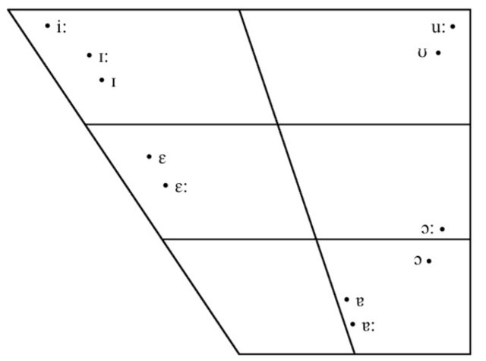

Slide 34
Vowels - III
Monophthong: A vowel that does not change its quality (also called pure vowels)
Diphthongs: There are some vowels, the quality of which is not constant, but changes from one vowel to another.

Slide 35
Phonetic Transcription
In English there is no one-to-one correspondence between spelling and pronunciation.
To overcome this problem a need had been felt to evolve an alphabet in which words of any language could be written unambiguously.
One such alphabet that is used extensively by phoneticians all over the world is the International Phonetic Alphabet, devised by International Phonetic Association.
It is claimed to have symbols to represent all the sounds that exist in the natural languages of the world.
It is used to transcribe words of any natural language.
It is based primarily on Roman Alphabet and a set of diacritics.

Slide 36
The English Sound System
English has 44 sounds
24 Consonants (cf. Table -1)
12 simple vowels or pure vowels (cf. Figure 2)
8 diphthongs (composed of two simple vowels)

Slide 37
Phonetics
Phonetics is the scientific study of SOUND system of languages.
Language has hierarchical structure
It has various levels
There are rules operating at each level of language study

Slide 38
Levels of Language Study
Phonetics: Study of sound
Morphology: Study of word formation
Syntax: Study of sentence formation
Semantics: Study of Meaning
Discourse: Connected speech
Lexicography: Dictionary

Slide 39
Received Pronunciation
Standard form of Spoken English
Documented in dictionaries for reference
Reference to analyse other languages
Originated in the South East of England

Slide 40
Continued....
We have a standard form of Written English all over the worlds
Do we have a standard form of Spoken English???
Try to pronounce these word:
Thermometer - Ther’mometer
Characterization- Characteri’zation
Articulate- Articulation, Ar’ticulate- Articu’lation
‘Photograph- Pho’tography- Photo’graphic
‘Family-Fa’miliar

Slide 41
What is General Indian English (GIE)?
Spoken form of English used in India
Indian English is not intelligible
No aspiration
Lacking in supra-segmental features like accent, intonation etc.

Slide 42
Sounds of RP
44 sounds
20 vowels
12 pure vowels
8 diphthongs
24 consonants
In English (R.P), there are 44 distinctive sounds. Twenty of these are vowel sounds and the remaining 24 are consonants sounds.

Slide 43
International Phonetic Alphabet (IPA)
The International Phonetic Alphabet (IPA) is a set of symbols that linguists use to describe the sounds of spoken languages.
This chart contains all the sounds (phonemes) used in the English language.
The aim of the International Phonetic Alphabet (IPA) was to provide a unique symbol for each distinctive sound in a language—that is, every sound, or phoneme, that serves to distinguish one word from another.

Slide 44
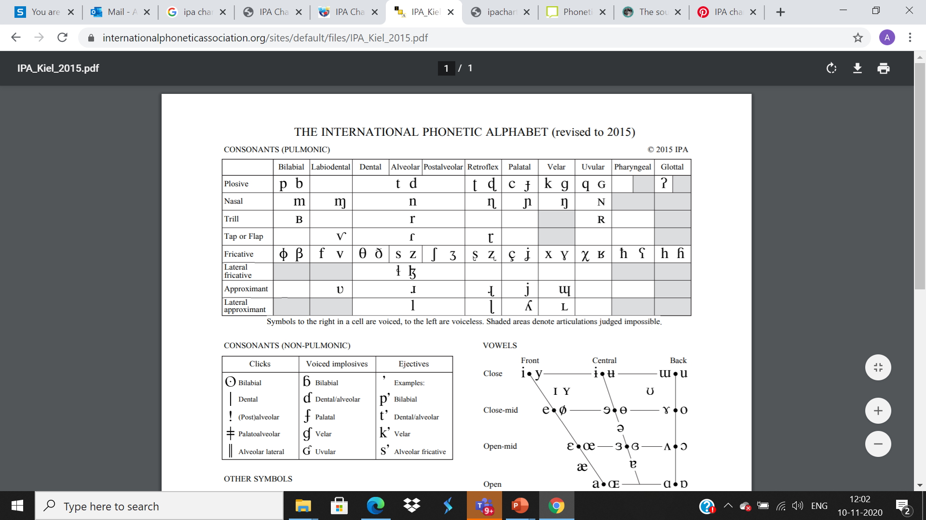
International Phonetic Alphabet (IPA)

Slide 45
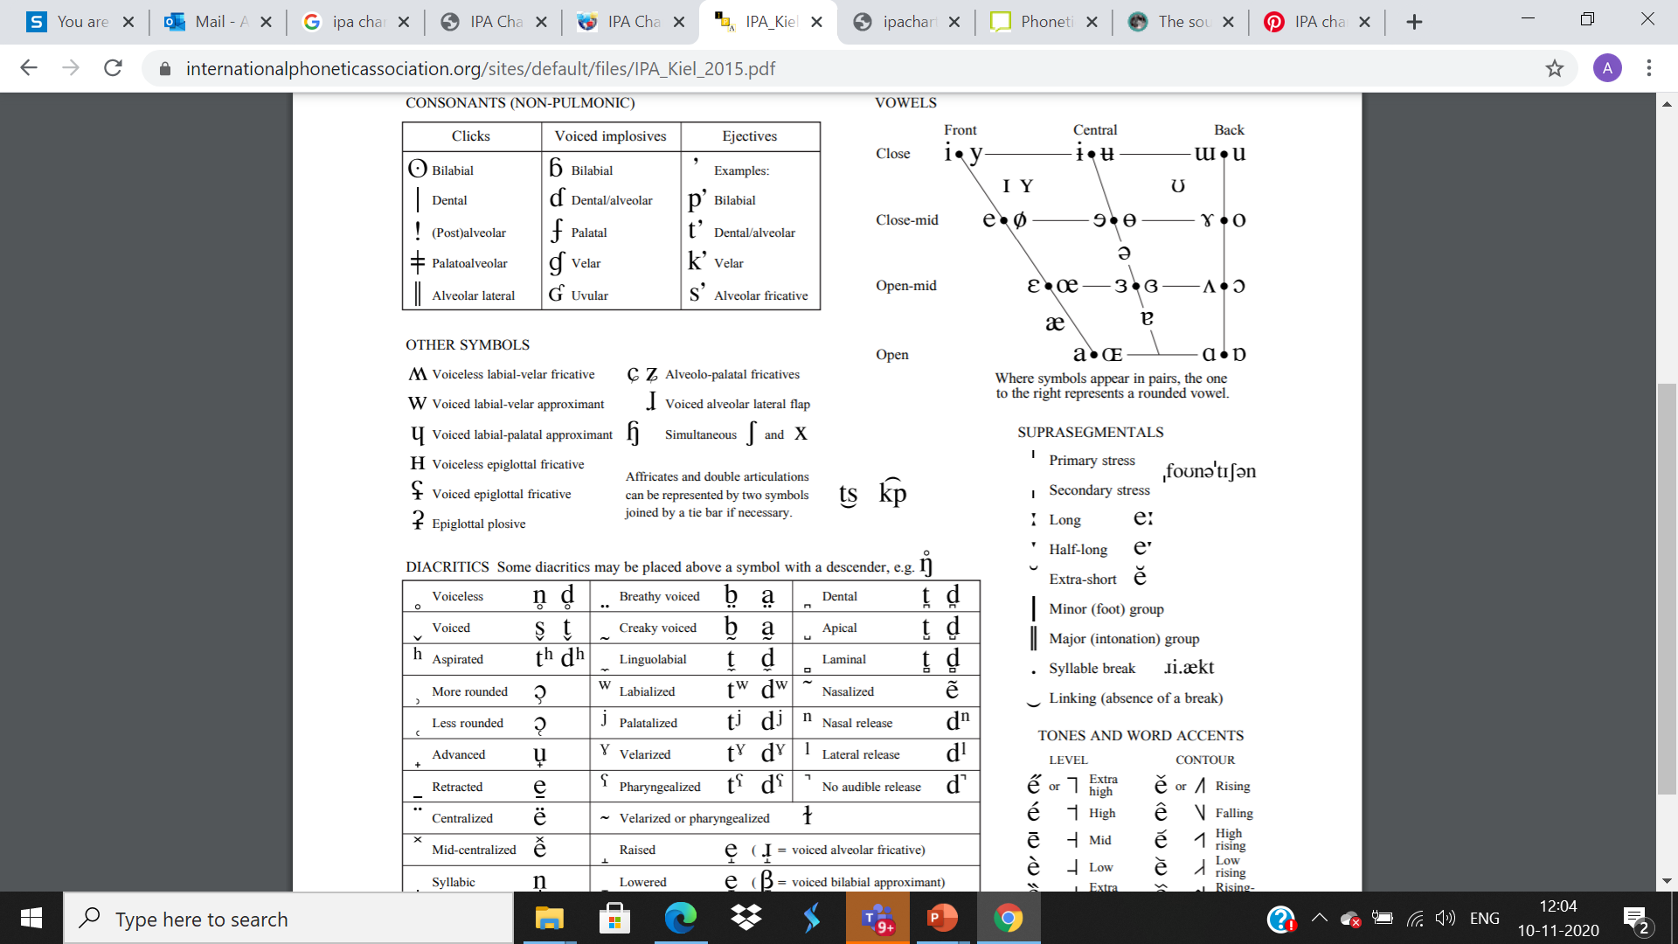

Slide 46
Concept of Pronunciation in RP
Spelling & Pronunciation: There is no one to one relation between the spelling of a word and its pronunciation.
Ex. Pronunciation of ‘ch’ in words like ‘machine’,
‘chemistry’, ‘chair’.

Slide 47
Consonants & vowels of RP
Vowels & Consonants:
Vowels are speech sounds in the production of which there is, in the pharynx and the mouth, no obstruction and no narrowing of a degree that would cause audible friction.
The consonants are mostly articulated via closure or obstruction in the vocal tract.

Slide 48
Consonant sounds of English
initially medially finally
1. /p/ pin spin keep
2. /b/ bin tubs club
3. /t/ tell stick light
4. /d/ day heads laid
5. /k/ keep skill stick
6. /g/ get jugs bag

Slide 49
Consonant sounds of English (continued)
initially medially finally
7. /ʧ/ chin reached teach
8. / ʤ / joke hinged large
9. /m/ met smoke team
10. /n/ net snake tin
11. /ŋ/ rings sing
12. /l/ lot fling full

Slide 50
Consonant sounds of English (continued)
initially medially finally
13 /f/ fan soft if
14. /v/ van leaves thief
15. /ɵ/ thin months bath
16./ð/ then clothes bathe

Slide 51
Consonant sounds of English (continued)
initially medially finally
17. /s/ sip list less
18. /z/ zip loser buzz
19. /ʃ/ ship rushed hush
20. /ʒ/ measure rouge

Slide 52
Consonant sounds of English (continued)
initially medially finally
21. /h/ hot behave
22. /r/ rot try
23. /w/ watt sweat
24. /j/ yatch tune

Slide 53
Vowel sounds of English
(Pure Vowels/Monophthongs)
initially medially finally
1. /i:/ east sheet key
2. /I/ it hit duty
3. /e / end send
4. /æ/ and sand
5. /a:/ art heart car
6. /ɒ/ ox fox

Slide 54
Vowel Sounds of English (continued)
initially medially finally
7. /ɔ:/ all ball saw
8. /U/ put
9. /u:/ ooze choose chew
10./∧/ up cup
11./з:/ earn learn stir
12. /ə/ ago police maker

Slide 55
Vowel sounds of English (continued) Diphthongs
13. /eɪ/ eight straight stay
14. /əʊ/ oak joke slow
15. /aɪ/ ice mice my
16./aʊ/ out shout how
17. /ɔɪ/ oil boil boy
18. /ɪə/ ears beard peer
19. /eə/ airs paired hare
20. /uə/ cured tour

Slide 56
THANK YOU

